Slide 1
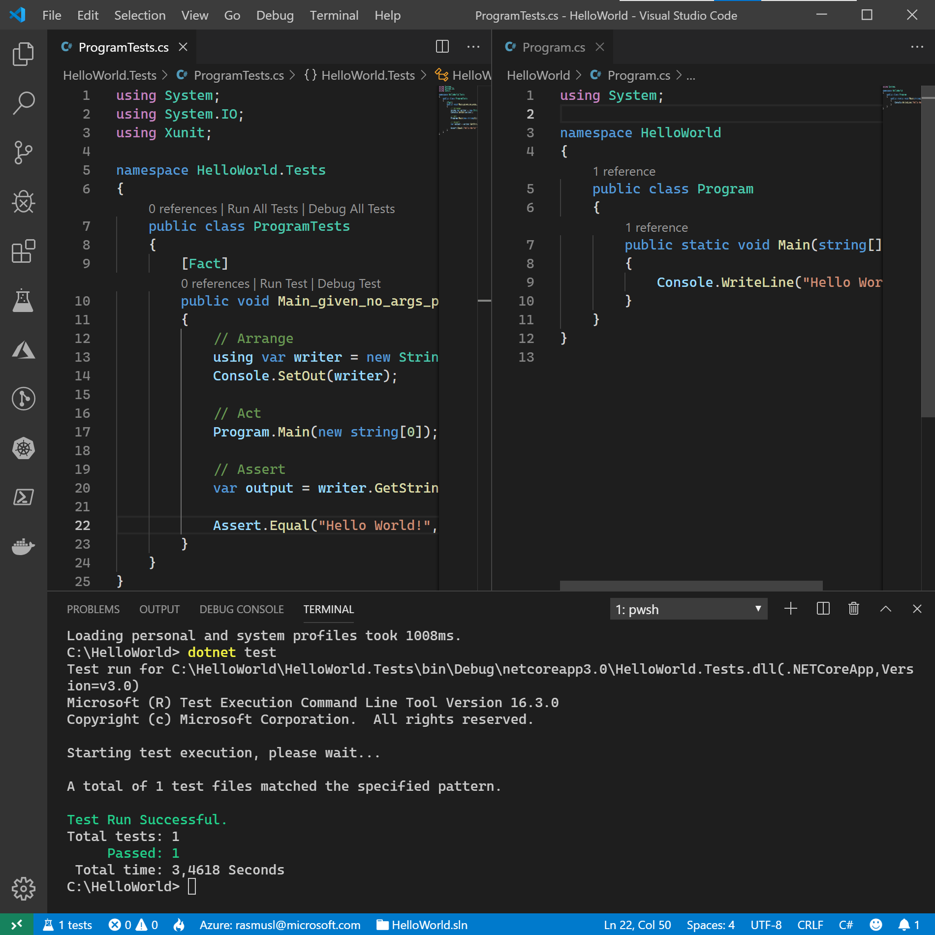
Test-Driven C♯
Rasmus Lystrøm
Associate Professor
ITU

Slide 2









2013-: Principal Consultant @ Microsoft DevOps, Cloud, Security
2014-: Associate Professor @ ITU Object-Oriented Programming, C♯, F♯, .NET Core
M.Sc. IT, ITU (2012) Thesis: Forecalc – Developing a core spreadsheet implementation in F♯
Hobbies
1996-2008, 2013-: Captain @ Danish Army (Reserve) Battalion Chief of Staff,
Wife: Katrine Children: Lærke (3), Laura (6), and Alma (13)
Origin: Aarhus Current whereabouts: Vanløse, Copenhagen

Slide 3
Agenda
How to reach me
Boring stuff
Test-Driven Development
Trunk Based Development
Continuous Integration
Show and tell

Slide 4
How to reach me
Do not write me an email!
Use Discord – the TA’s or your fellow students might have the answer.
You may tag me.
You may DM me for personal questions.

Slide 5

Curriculum
Test-Driven C♯
Generics
Lambdas and Linq
Data access (ORM)
Asynchronous and parallel
Web APIs
Design Patterns
Mobile and desktop apps
Web apps
Security
Cloud
Updated on LearnIT

Slide 6
“C# is intended to be a simple, modern, general-purpose, object-oriented programming language.”
ECMA-334 ISO/IEC 23270:2018(E)
C# language specification, 5th edition, December 2017

Slide 7
Why C♯
Popular - Stack Overflow Developer Survey 2021
Ubiquitous
Open Source
Cross-platform
Industry / Enterprise
Tool for your toolbox
IRON

Slide 8
Why not C♯?
It’s just like Java:
Curly brackets and semicolons from C
Statically typed
Object-oriented
Single inheritance
Cross platform
Open source
Industry / enterprise

Slide 9
Enterprise
https://github.com/joaomilho/Enterprise
https://github.com/EnterpriseQualityCoding/FizzBuzzEnterpriseEdition

Slide 10
Build on what you know already
No basic stuff
Read the book
Do the exercises
Learn the advanced patterns and syntactic sugar
Idiomatic C♯
Focus on clean, testable code
Stop the enterprise madness!

Slide 11

.NET – a brief introduction

Slide 12
.NET
.NET is a free, cross-platform, open-source developer platform for building many different types of applications.

Slide 13
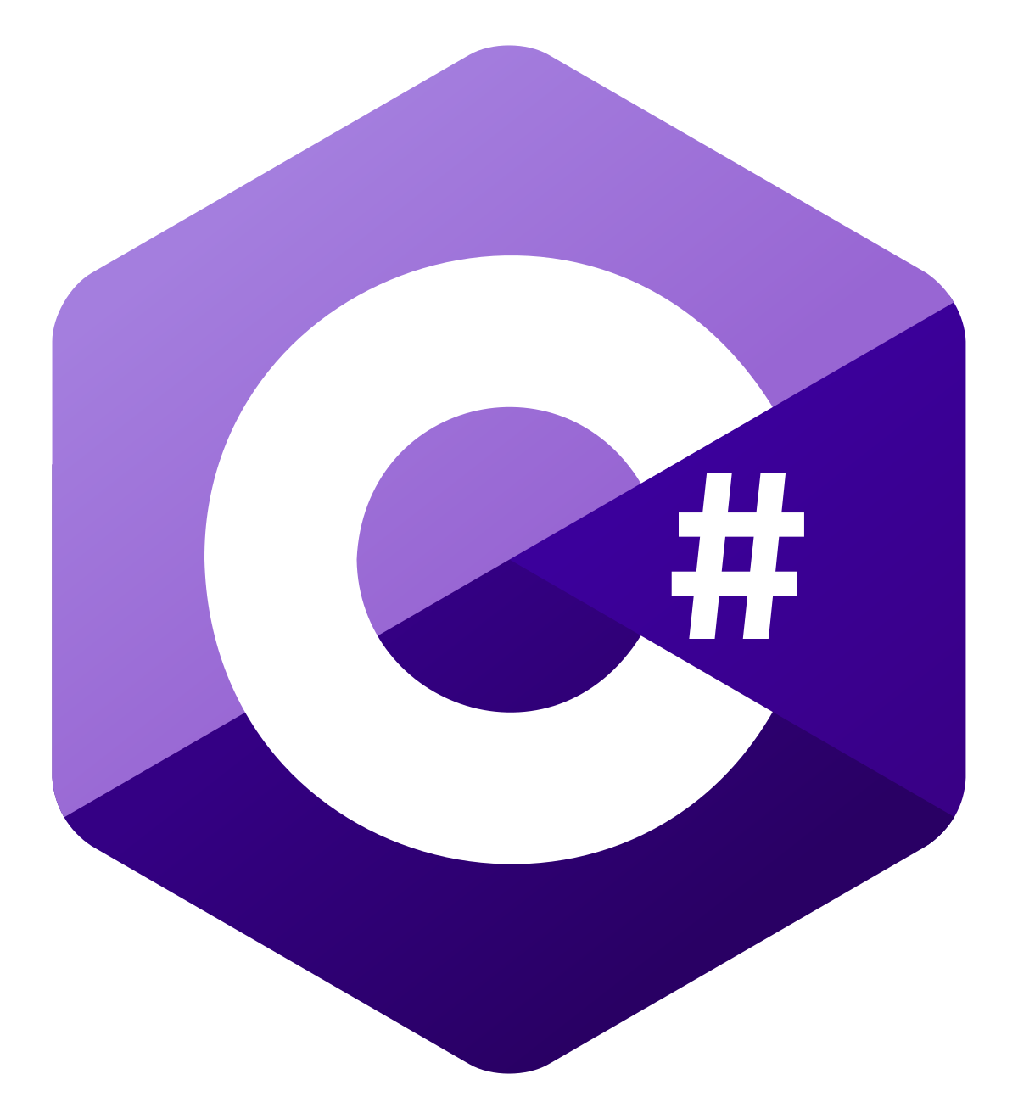


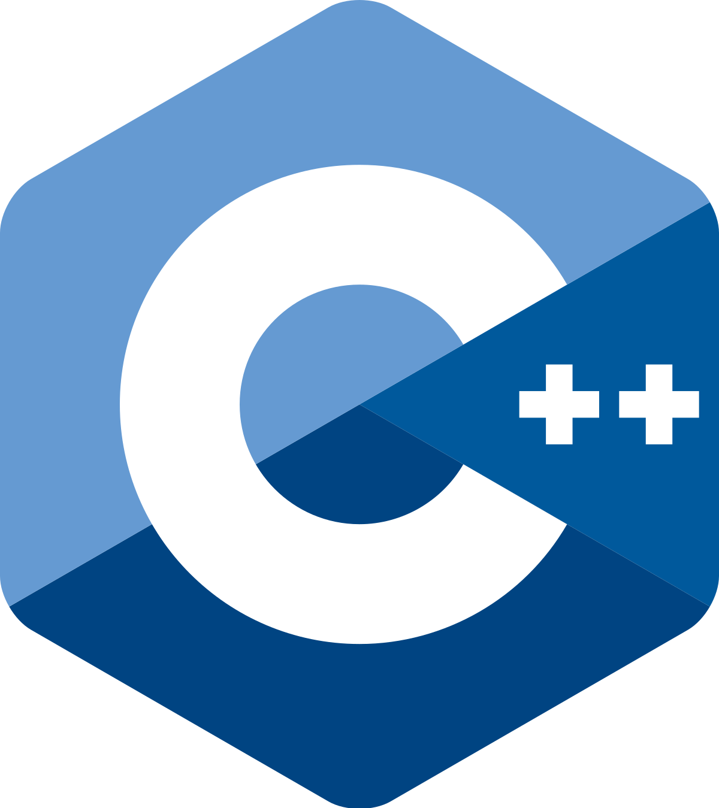



.NET Languages

Slide 14





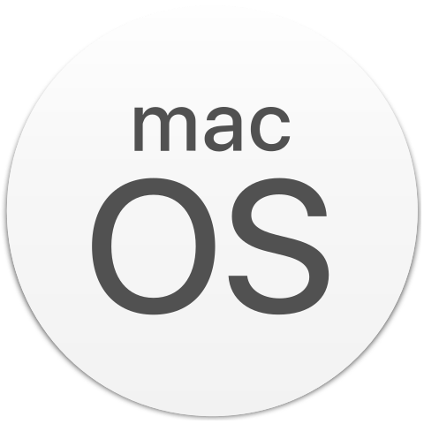


.NET Platforms

Slide 15
.NET Timeline
.NET 1.0
.NET 3.5
.NET 4.5
Visual Studio .NET
Visual C♯ 1.0
Visual Basic .NET
Visual J++
Visual C++ .NET
Visual Studio 2008
C♯ 3.0
Auto properties
Linq
Lambda expressions
Implicit typed local variables
Object and collection initializers
Visual Studio 2012
C♯ 5.0
F♯ 3.0
Async/await
2002
2005
2007
2010
2012
2015
.NET 4.0
.NET 4.6
.NET 2.0
Visual Studio 2010
C♯ 4.0
F♯ 2.0
Dynamic
C♯ 6.0
F♯ 4.0
Syntactic sugar
Visual Studio 2005
C♯ 2.0
F♯ 1.0
Generics
https://docs.microsoft.com/en-us/dotnet/csharp/whats-new/csharp-version-history

Slide 16
.NET Timeline II
.NET Core 1.0
.NET Core 3.0
.NET 6
Open Source on GitHub!
Visual Studio Code 1.0
Visual Studio 2019
C♯ 8.0
A lot of sugar!
Visual Studio 2022
C♯ 10.0
November 9
https://www.dotnetconf.net/
2016
2017
2019
2020
2021
2022
.NET 5
.NET 7
.NET Core 2.0
C♯ 9.0
F♯ 5.0
A lot of sugar!
?
Visual Studio 2017
C♯ 7.0
Syntactic sugar
https://docs.microsoft.com/en-us/dotnet/csharp/whats-new/csharp-version-history

Slide 17

Test-Driven Development

Slide 18
Test-Driven Development
What?
Why?
How?

Slide 19
Red – Green - Refactor
[Start]
Add a test
[No]
[Pass]
Run the tests
Done?
[Fail]
[Yes]
Refactor
[End]

Slide 20

Trunk Based Development

Slide 21
Trunk Based Development
A source-control branching model, where developers collaborate on code in a single branch called ‘trunk’ *, resist any pressure to create other long-lived development branches by employing documented techniques. They therefore avoid merge hell, do not break the build, and live happily ever after.
master/main, in Git nomenclature
Source: https://trunkbaseddevelopment.com/

Slide 22
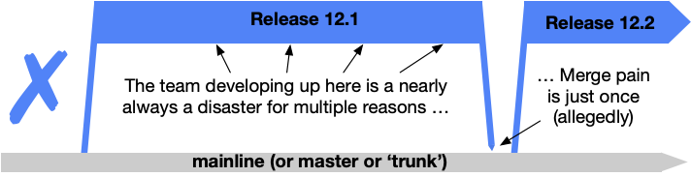
Shared branches off mainline/master/trunk are bad at any release cadence

Slide 23
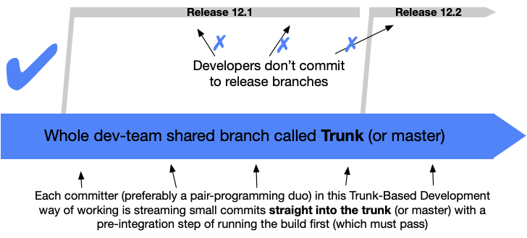
Trunk Based Development

Slide 24
Branching strategy vs. tactics
Short-lived < 1 day
No strategy!

Slide 25
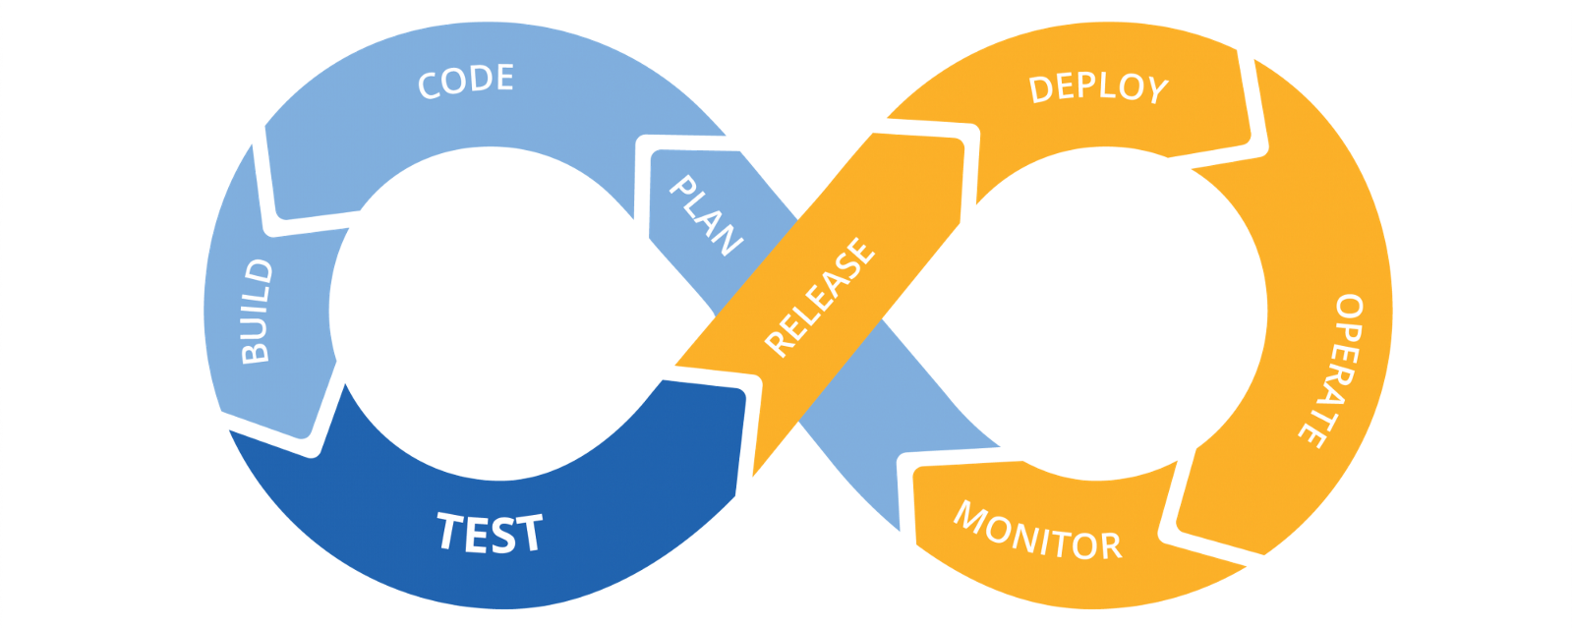
Continuous Integration
This Photo by Unknown Author is licensed under CC BY-SA-NC

Slide 26
Continuous Integration
Continuous Integration (CI) is the process of automating the build and testing of code every time a team member commits changes to version control.
Source: https://docs.microsoft.com/en-us/devops/develop/what-is-continuous-integration

Slide 27
Demo
Test-Driven C♯ using Continuous Integration and Trunk Based Development

Slide 28

Thank you

Slide 29
Appendix

Slide 30

Create a C# console app with a test library
mkdir MyApp
cd MyApp
dotnet new console -o MyApp
dotnet new xunit -o MyApp.Tests
dotnet new sln
dotnet sln add MyApp
dotnet sln add MyApp.Tests
dotnet add MyApp.Tests reference MyApp

Slide 31

Build, test, and run your app
dotnet build
dotnet test
dotnet run --project MyApp

Slide 32
Naming conventions
Composed names
currentLayout, CurrentLayout
Variables and fields
vehicle, leftElement
Private fields
_vehicle, _leftElement
Methods
CurrentVehicle(), Size()
Properties
Pi, Name, Size
Classes
MyClass, List<T>
Interfaces
IException, IObserver
https://docs.microsoft.com/en-us/dotnet/standard/design-guidelines/naming-guidelines

Slide 33
The C# class
using System;
namespace Namespace
{
public class Class
{
private string _field;
protected DateTime _inheritableField;
public string Property { get => _field; } // Getter
public int AutoProperty { get; set; }
public Class() // Constructor
{
}

Slide 34
The C# class (methods)
public object InstanceMethod(int parameter)
{
return null;
}
public virtual object OverridableInstanceMethod(bool parameter)
{
return null;
}
public static void StaticMethod()
{
}
private void PrivateInstanceMethod()
{
}

Slide 35
The C# class (events and delegates)
public event EventHandler Event;
protected virtual void OnEvent(EventArgs e)
{
EventHandler handler = Event;
handler?.Invoke(this, e);
}
}
public delegate void MyEventHandler(object sender, EventArgs e);
}

Slide 36
Built-in types
bool boolean; // true || false
char character; // 'a', 'b', 'c', '1', '2', '3'
// Floating point numeric types
decimal precisionFloatingPoint;
double floatingPoint64bit;
float floatingPoint32Bit;
// Integral numeric types
byte integer8bit; sbyte signedByte;
int integer32bit; uint unsignedInteger32bit;
long integer64bit; ulong unsignedInteger64bit;
short integer16bit; ushort unsignedInteger16bit;
// Reference types
object _object;
string _string;
dynamic dynamic;
https://docs.microsoft.com/en-us/dotnet/csharp/language-reference/builtin-types/built-in-types

Slide 37
Basic Unit Test
public class Ticker
{
public int Counter { get; private set; }
public void Increment() => Counter++;
}
public class TickerTests
{
[Fact]
public void Increment_when_called_increases_Counter_by_1()
{
// Arrange
var sut = new Ticker();
// Act
sut.Increment();
// Assert
Assert.Equal(1, sut.Counter);
}
}

